Slide 1
Analytical Benefits of a Smartphone-Based Survey from a Smaller Region
Lethal Coe, WCOG
June 4, 2019

Slide 2
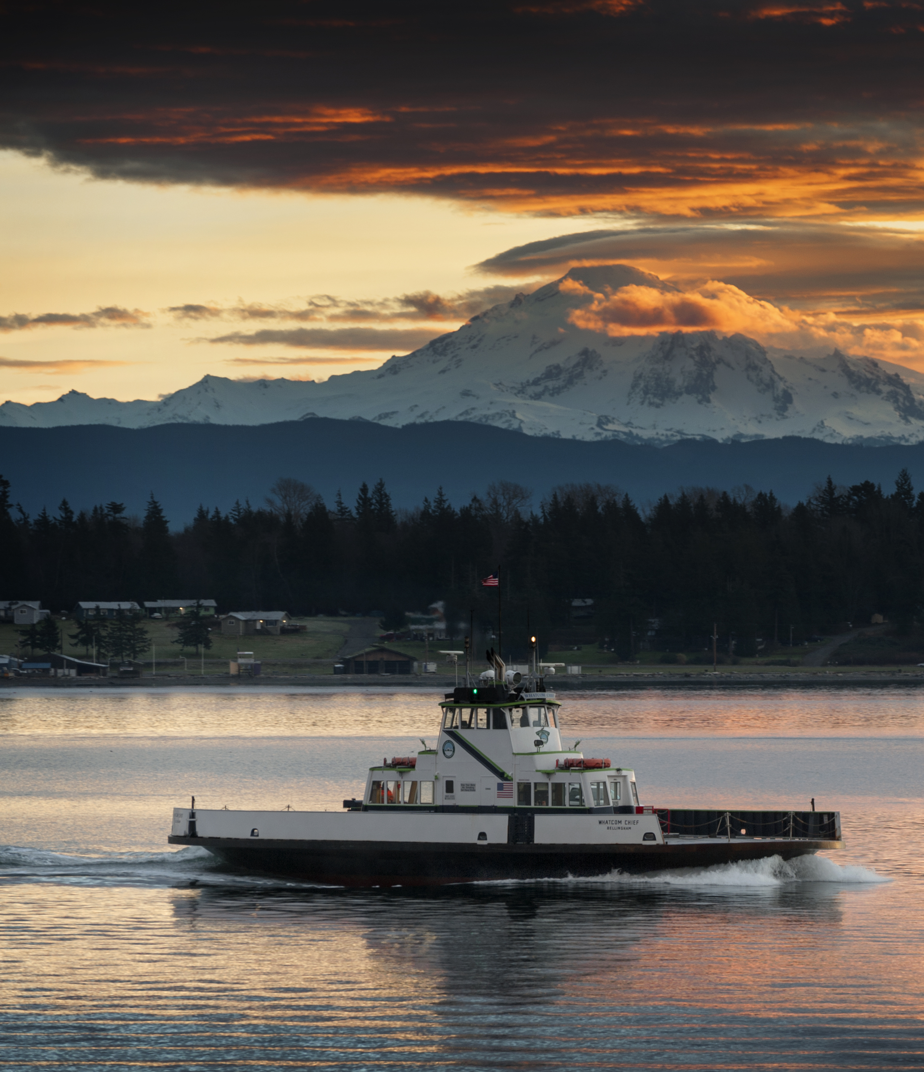
Presentation Overview
About WCOG and the study region
How we use our travel survey data
About the 2018 travel survey
Benefits of multi-day smartphone survey data
Key takeaways and next steps

Slide 3
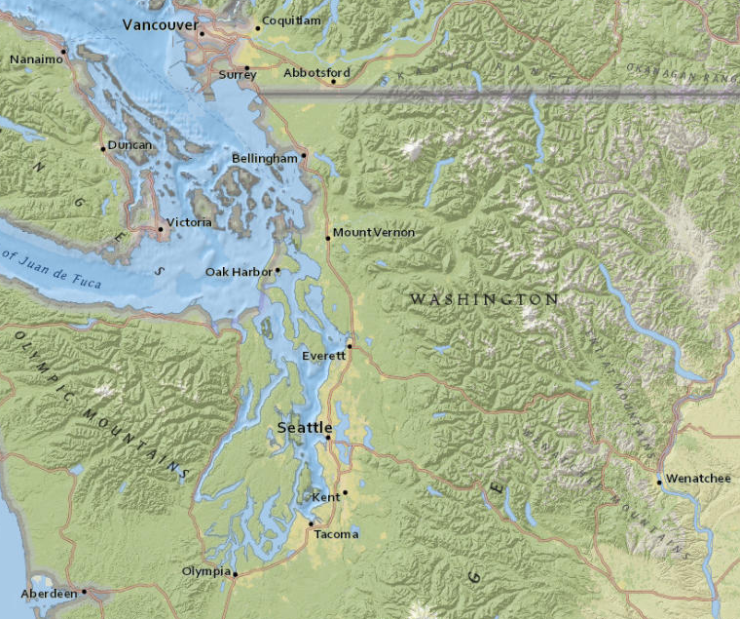
About WCOG and the Study Region
The Whatcom Council of Governments (WCOG) provides a variety of services and programs for the 90K+ households (210K+ residents) of Whatcom Region in NW Washington.
Study Region:
45 miles south of Vancouver, B.C.
90 miles north of Seattle, WA
Key Transportation Topics:
High passenger and freight volume at U.S. – Canadian border crossing
Increase in ride-hailing / decrease in bus ridership
Increase in urban bicycling
Rapid population growth in past 10 years (many who commute to jobs outside the region)
Notes:
[Summarize region location]
Key Transportation Topics:
Transportation activity has been changing quickly over the past 10 years, but we need to measure it to really know.
Having rich, up-to-date data is key for keeping track of growing trends and changes in demand.

Slide 4
WCOG uses survey data for several purposes, including:
General transportation planning
Regional long-range transportation plan
County-wide comprehensive plan
City-level comprehensive plans
Transit planning
Border transportation planning
Corridor and sub-area planning
Trip-based travel demand modeling
Trip rates by purpose and mode
Trip origins and destinations
Trip distance and time-of-day distributions
Active transportation planning
Smart Trips program support
City of Bellingham “complete networks” implementation – Transportation Report on Annual Mobility (TRAM)
Understanding special travel markets
College and university student travel
Cross-border travel (of residents)
Long-distance commuters to Seattle & Vancouver
Notes:
We use HTS data to inform many of our programs and plans.
This goes beyond it’s use in our next model update – HTS data helps us with general transportation planning, active transportation planning, and understanding special travel markets.
Data volume and quality are especially important for the niche planning areas.

Slide 5
The 2018 WCOG HTS covered 1,451 households, with 60% using smartphones to collect travel data for up to 7 days.
2018 Study Design:
Online “recruitment” survey.
7-day smartphone or 1-day online travel diary.
Gift-card incentives varied based on survey method.
High-Level Results:
1.8% final sample rate*
3,000 persons in complete households
13,107 complete person-days of travel
47,874 trips on complete travel days
Travel Diary Method
(Among Complete Households)
* Sample Rate = Households in Final Sample / Total Households in Region.
Notes:
[Stick to the text on the slide, mostly]
All households recruited using an online survey. Eligible households were then asked to complete the travel diary survey in a smartphone app while the remaining households completed the survey online.
Most households (60%) participated for up to 7-days using a GPS-based smartphone app to complete their travel diaries.

Slide 6
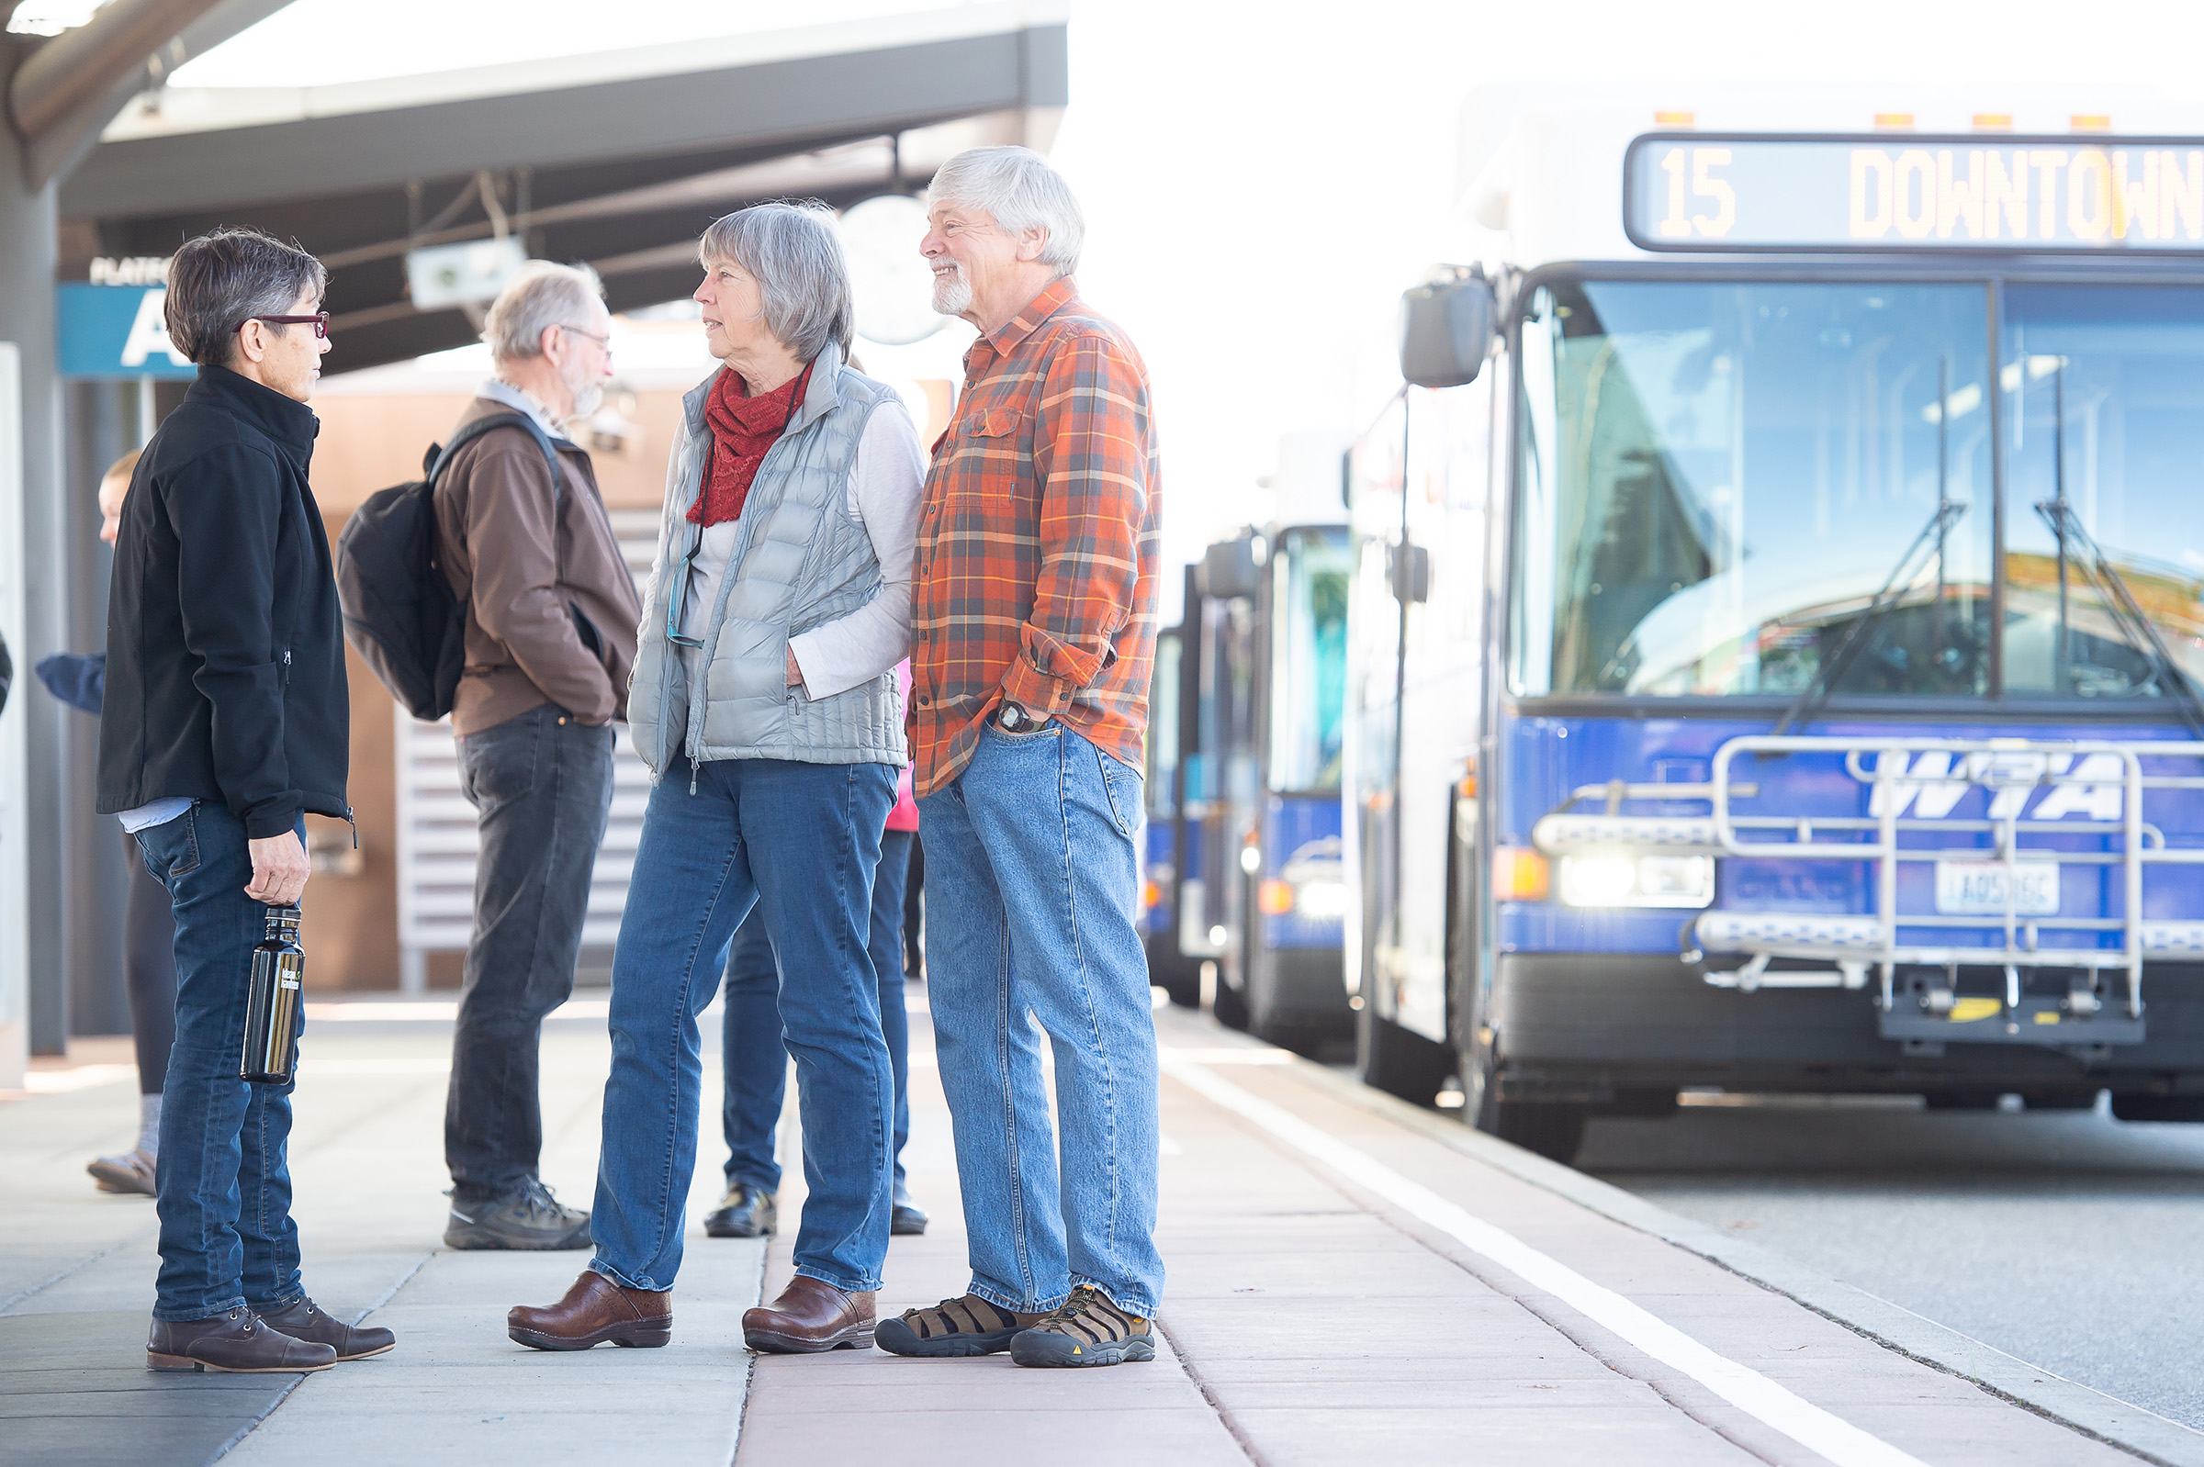
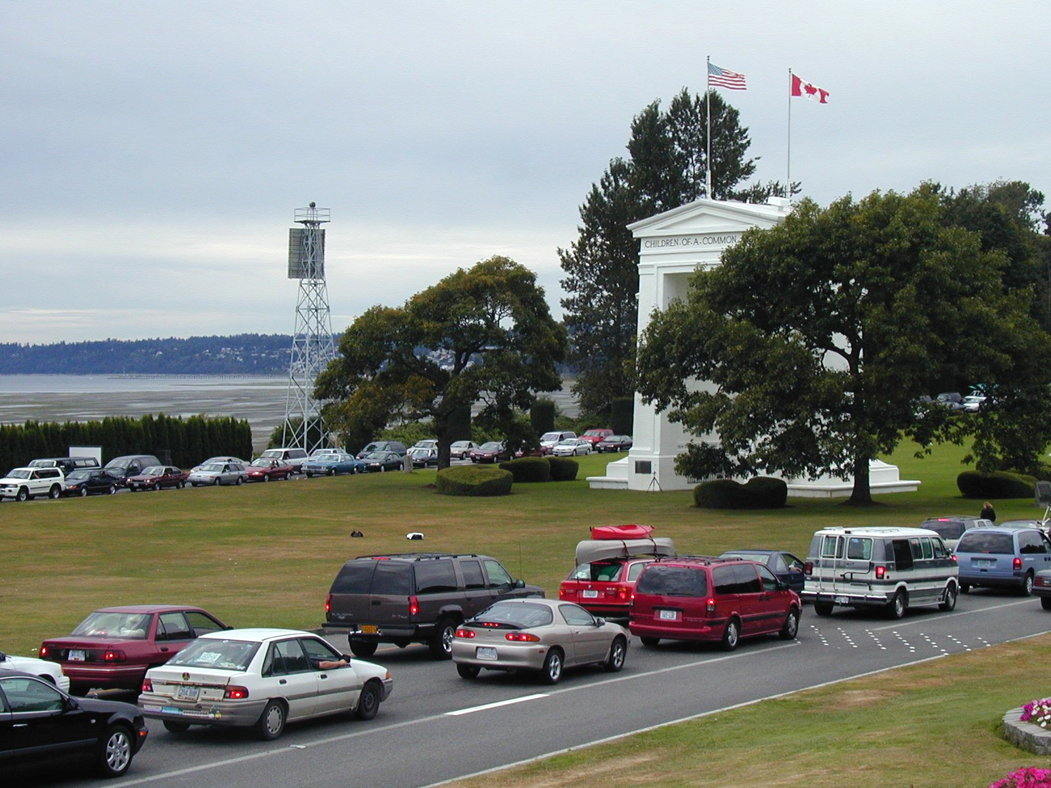
The smartphone-based study approach helped provide greater quantity and quality data, supporting many WCOG’s use cases.
This presentation will specifically focus on the study’s impacts on:
Increased person and trip counts for rare and important behaviors
Trip rate analysis (smartphone vs. online)
Spatial coverage
Notes:
[stick to text on the slide]

Slide 7
Multi-day data collection provided more insight into rare travel behaviors and weekend-specific travel.
112
Persons Biked
on Day 1
147
Persons Biked
Only Days 2-7
131%
Increase in Unique Bicyclists
24
Persons Made Trips to
British Columbia
on Day 1
71
Persons Made Trips to
British Columbia
Only Days 2-7
196%
Increase in
Cross-Border
Travelers
Notes:
Given that most participants provided more than one day of data, we were able to collect a higher share of high-priority or rare travel behaviors for the region.
For example, 112 persons biked on day one of their travel periods, but an additional 147 people only biked on days 2-7. A single day of data collection would have missed more than half of bicyclists in the study sample.
Similarly, there was a 196% increase in cross border trips when looking at 7 days of travel instead of just day one. This increase in travelers translates to about 9x the cross border trips.
Active transportation trends and cross-border travel are both key topics in our region, so capturing this additional data provides a lot of value.

Slide 8
The smartphone approach resulted in higher trip rates overall, including non-auto trips (walk, bike, transit).
Mode | 2008 | 2018 | % Change
Auto | 3.08 | 3.73 | +21
Walk | 0.41 | 0.59 | +45
Bike | 0.11 | 0.14 | +27
Transit | 0.07 | 0.13 | +80
Other | 0.13 | 0.11 | -17
Total | 3.8 | 4.7 | +24
Notes:
When we compare the results of our 2018 study to our previous study in 2008 (which did not include a smartphone element), we see that trip rates increase meaningfully across nearly every mode, including a 24% increase overall.
This is likely a combination of changes in travel behavior and changes in data collection methods.

Slide 9
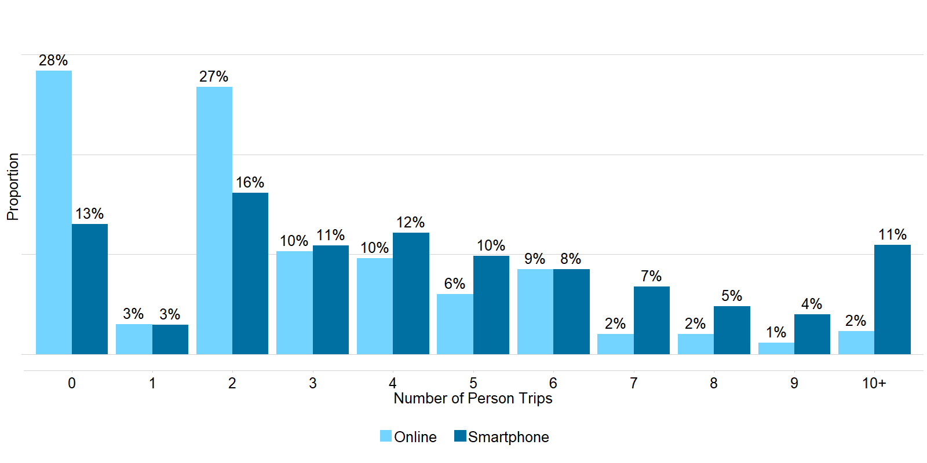
Smartphone data collection captured more accurate trip counts compared to the manual data collection.
Notes:
This slide compares the trip rates in the 2018 study by method of participation>
Smartphone data consistently captures higher trip shares than the online survey method.
In the figure shown here, smartphone participants reported both a lower share of zero-trip days and a much higher share of 10+ trip days.
There are two reasons for this: First, the demographics of smartphone owners are different than non-smartphone owners (often older). The second reason for this increase is that smartphones are better at capturing full trip and tour details, providing higher trip rates. These two reasons are roughly equally important in explaining the difference in trip rates.

Slide 10
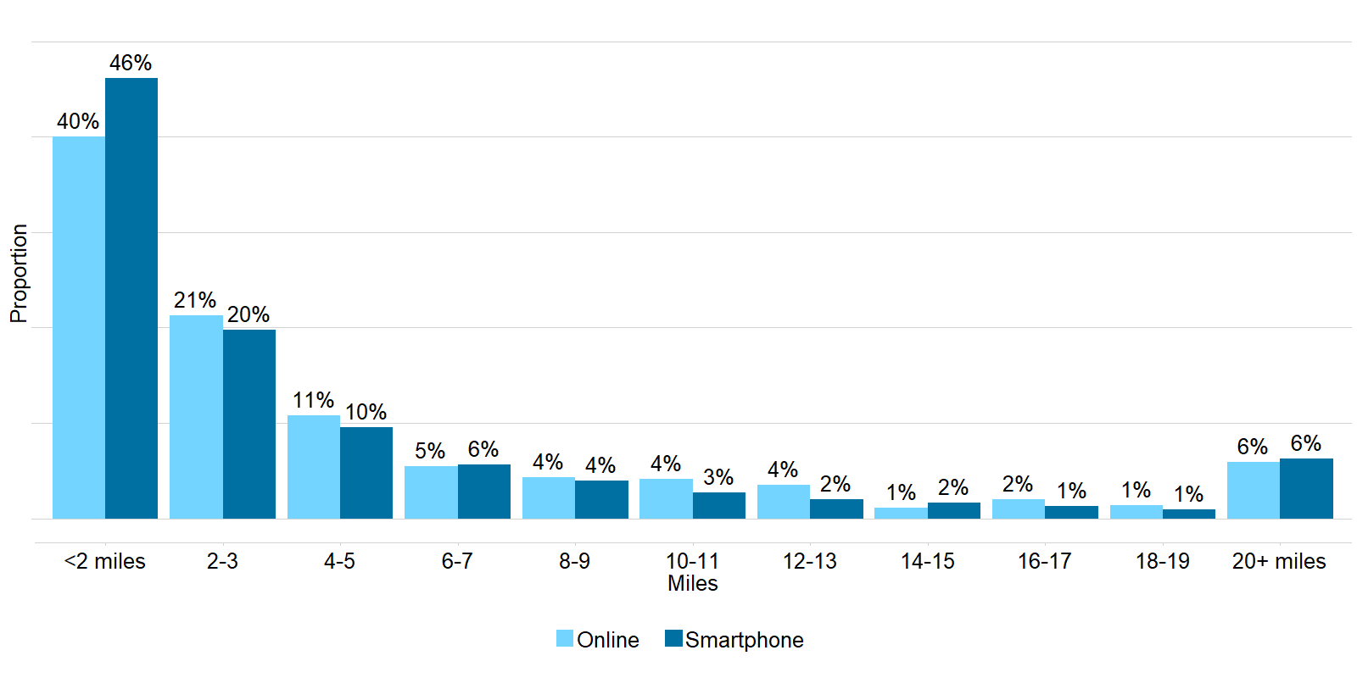
Smartphones collected higher shares of short-distance trips compared to the manual data collection.
Notes:
This slide looks at the distribution of trip distances by method of participation.
Short trips (under two miles) are often under-reported, either because participants forget the trip or don’t think to count them as trips. (Example forgotten trips might include short walk trips to get coffee or run to a pharmacy during the workday.)
This underreporting contributes to the overall higher trip rates among participants using smartphones.

Slide 11
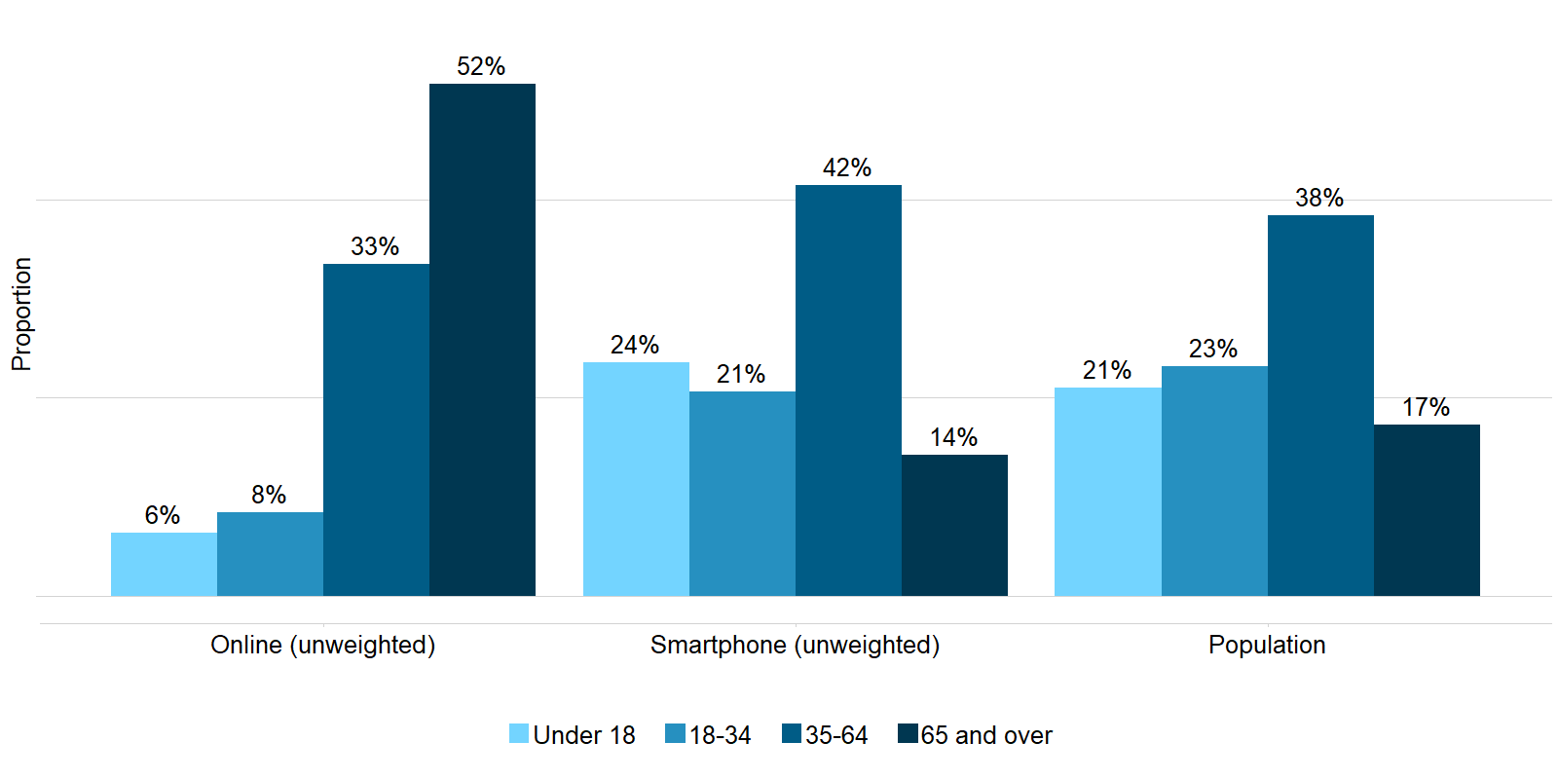
Smartphone participants were younger and matched the population age distribution more closely.
*Population is represented by weighted data figures.
Notes:
In terms of demographics, the smartphone participants also match the true population much more closely.
The figures here show unweighted age distributions by survey mode compared to the total population. Younger age groups on the left, and older age groups on the right of each group.
Non-smartphone participants typically tend to be much older than those who participate by smartphone. (Age is a primary indicator of smartphone ownership).
This is an important distinction because age greatly impacts travel behavior and correlates with other travel determinates, like employment status.

Slide 12
Higher trip counts also increased spatial coverage across study and neighboring regions.
Destination Region | Work and Work-related Trips %
Bellingham | 59.7
Rest of Whatcom | 26.8
Outside of Whatcom | 13.4
Work trip ends (with added noise to preserve anonymity)

Slide 13
Key Takeaways and Next Steps
Key Takeaways From the Study
Smartphone-based survey collected richer and more representative travel data.
Smartphone data collection captured higher trip rates overall, partially due to the higher share of short-distance and easy-to-forget trips.
Multi-day data collection significantly increased the size of our dataset.
Combined smart-phone diary (60%) and traditional online/phone diary (40%) captured optimal demographic representation.
Persons over 65 and lower income households still needed online option.
Next Steps
Develop webpage (wcog.org) that includes access to data and reports.
Further investigate trip makings and location-based data.
Perform subarea analyses.

Slide 14
LETHAL COE, WCOG
SENIOR PLANNER
Lethal@wcog.org
CHRISTOPHER COY, RSG
SENIOR CONSULTANT
Christopher.coy@rsginc.com
ABIGAIL ROSENSON, RSG
ANALYST
Abigail.rosenson@rsginc.com
ELIZABETH GREENE, RSG
DIRECTOR
Elizabeth.greene@rsginc.com

